Slide 1

Primetime kommunikation
People are not idiots!
- they are your customers!
Finland, 10.02.2012
Key note speaker Anna Thygesen,
Director PrimeTime Kommunikation

Slide 2
About Anna Thygesen
Expert in customer values
Expert in female buying behavior
Director in PrimeTime Kommunikation
20+ years of experience from corporate sales, marketing and communication
Key note speaker
Debater, writer and engaged opinion leader

Slide 3



Denmark’s third largest PR and communication agency
2011
2010
34 employees
  Strategic Partnership with Capital Relations
  Strategic Partnership with Grayling
  Rated Top 2 PR agency by Bureaubiz/Børsen
2009
30 employees
  Turnover: 30 m. DKK
  GLOBAL CSR
  PrimeTime Analysis
  PrimeTime Diva
2008
25 employees
Public Affairs
2006
22 employees
Partnership - Worldcom
2001
12 employees
PrimeTime Campaign
PrimeTime Kommunikation A/S founded by Peter Sterup and Lise Westphal

Slide 4

Products on the shelves
PR and strategic communication
Press relations
Media and TV training
Promotions & Events
Crisis management
Public Affairs
Media Analysis and reports
Text Work and magazines
Customer insights
Sales and service development

Slide 5


Clients

Slide 6





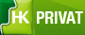

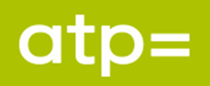























Clients

Slide 7



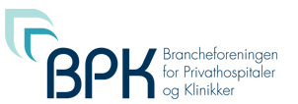



























Clients

Slide 8
Theories……
Companies don’t know enough about customer values..
Companies don’t know enough about customers buying behavior..
Companies tend to develop new products and services because they can - not because there is a need for it..
Companies tend to confuse the 2 expressions service and servile..
We don’t need (as in Maslow’s hierarchy of needs) most products..
What’s in it for me – refers to the customers not the company..

Slide 9

Avenue Hotel experience

Slide 10
Hotel workshops
Learning by doing – PrimeTime service workshops in the hotel business
Research - interview sessions with hotel guests
Business development - definition of customer needs
Production - meet customer needs
Evaluate and apply to own business

Slide 11
Service Profit chain
Customer loyalty drives profit and growth
Customer satisfaction drives customer loyalty
Value drives customer satisfaction
Employee productivity drives value
Employee loyalty drives productivity
Employee satisfaction drives loyalty
Internal quality drives employee satisfaction

Slide 12
How successful are you?
Your ability to listen to your customers and what they tell you about their life and secondary how your product fits into that!
Your ability to look at your product, your company and your brand with the customer’s eyes!
Your ability to look at yourself as a whole where all parts of your brand is worth the customer’s money!

Slide 13
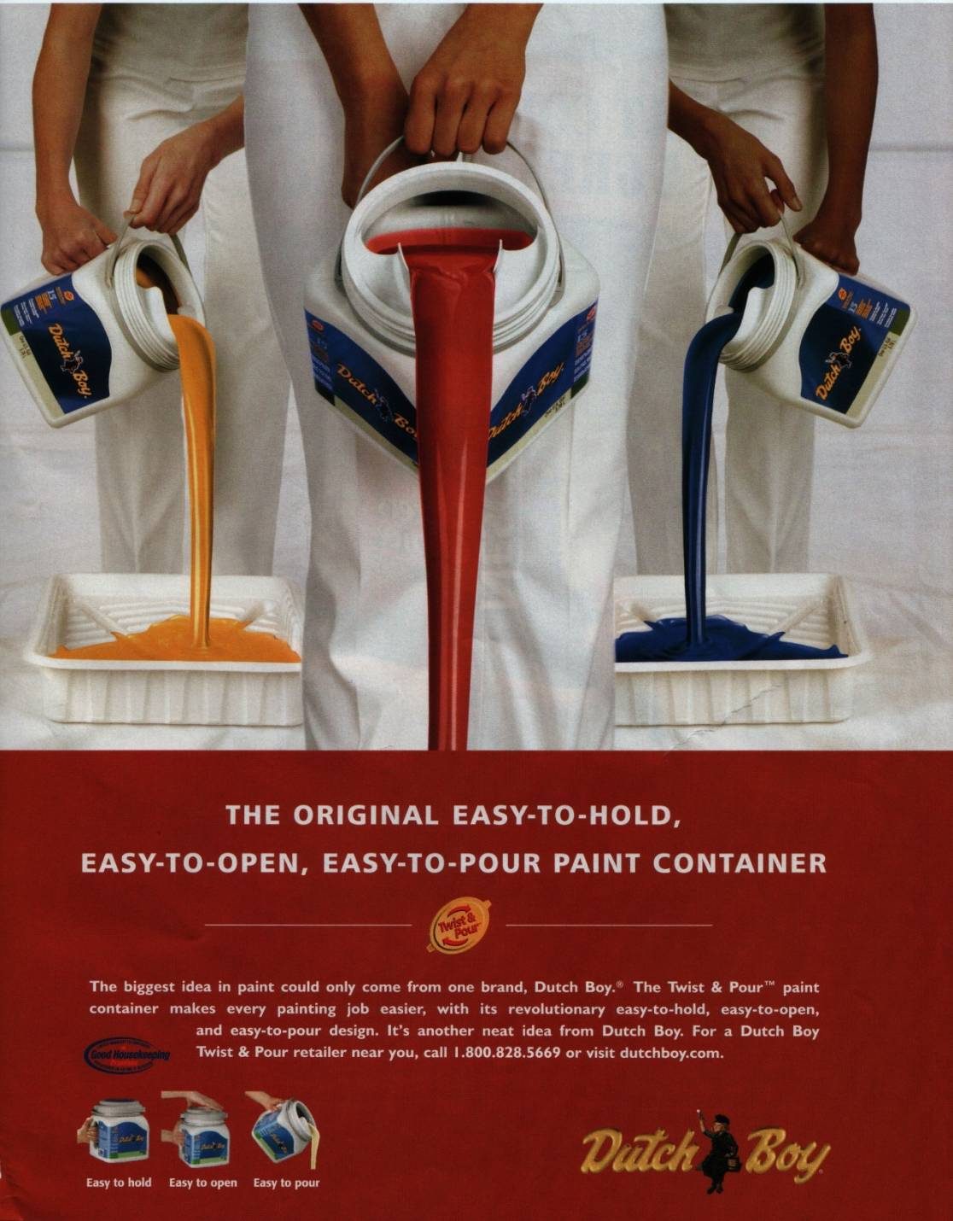
Customer needs

Slide 14

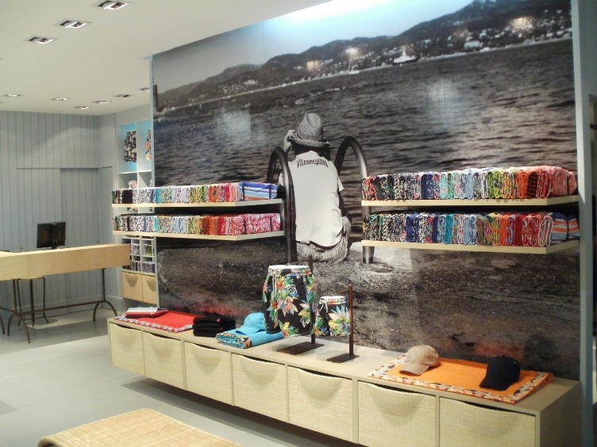

Customer needs

Slide 15


Slide 16
Customer needs – your market!
Your products alone - don’t catch your customers attention!
The customers get caught by your products ability to cover a need in their life - right now!
- show your customers that context and they will like you (and buy from you)
.

Slide 17
Nice to know about customers
You have to earn a place in your customers life!
Not the other way around!
The customer does not have to earn a place in your life!

Slide 18
Key Learning
Your customers will tell you exactly what they need –
If you listen!
Thank you!

